Slide 1
SQL Server & Containers

Slide 2
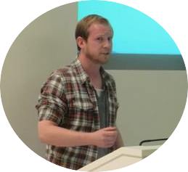
About Me
Andrew Pruski
@dbafromthecold
dbafromthecold@gmail.com
www.dbafromthecold.com
SQL Server DBA & Data Platform MVP
Originally from Wales, now living in Dublin

Slide 3
Session Aim
To give you a base of knowledge to be able to start to experimenting with containers

Slide 4
Agenda
Container theory
Building your first container
Creating a custom container image
Pushing custom image to the Docker Hub
Persisting data
Portainer

Slide 5
Container Definition
Containers wrap a piece of software in a complete filesystem that contains everything needed to run: code, runtime, system tools, system libraries – anything that can be installed on a server. This guarantees that the software will always run the same, regardless of its environment.
https://www.docker.com/what-docker

Slide 6
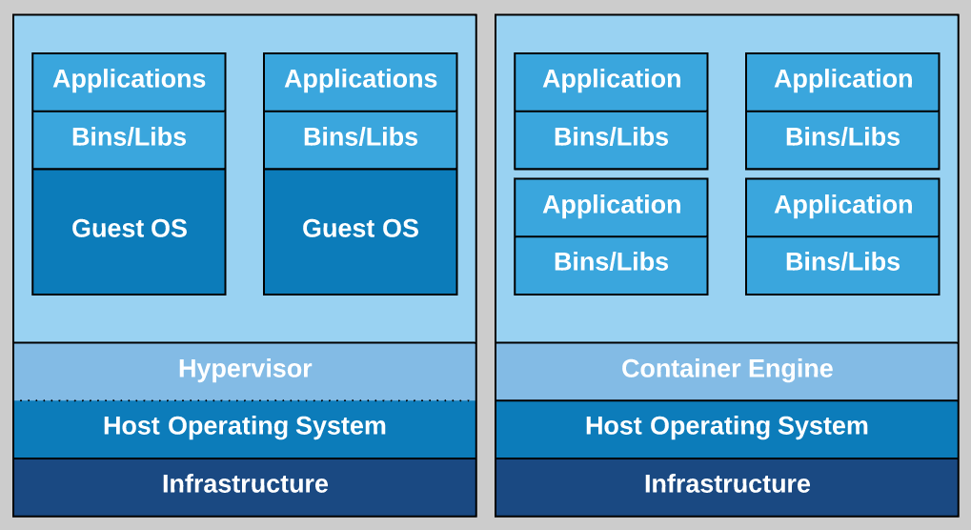
Virtual Machines vs Containers

Slide 7
Pros
Simple and fast setup
New containers can be spun up in seconds
Relatively low footprint compared to VMs
Ability to customise images
Access to Docker repository (hundreds of images available)
Portability, images can be saved to the Docker Hub

Slide 8
Cons
No windows authentication
Only supported on Windows Server 2016 / Windows 10 Anniversary Edition
Official SQL Server images for 2016 & 2017 only
SQL images aren't the smallest (~13GB)
Suitability for production?

Slide 9
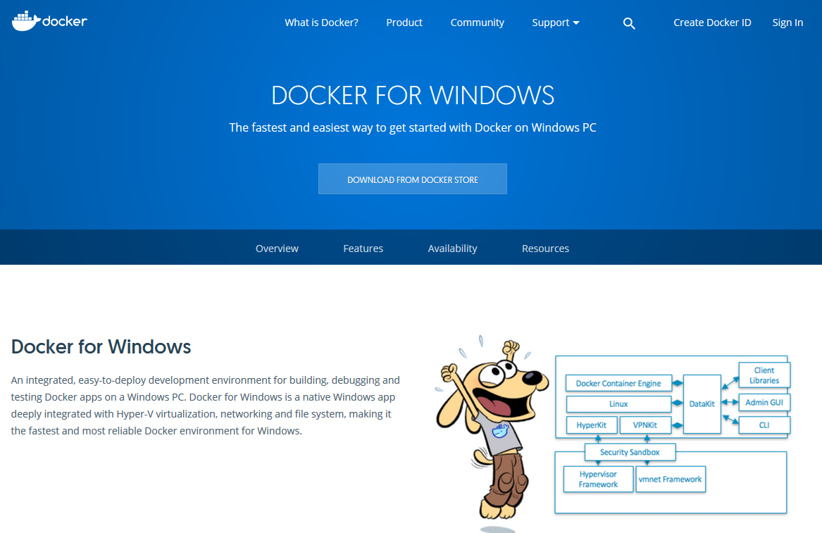
Docker for Windows

Slide 10
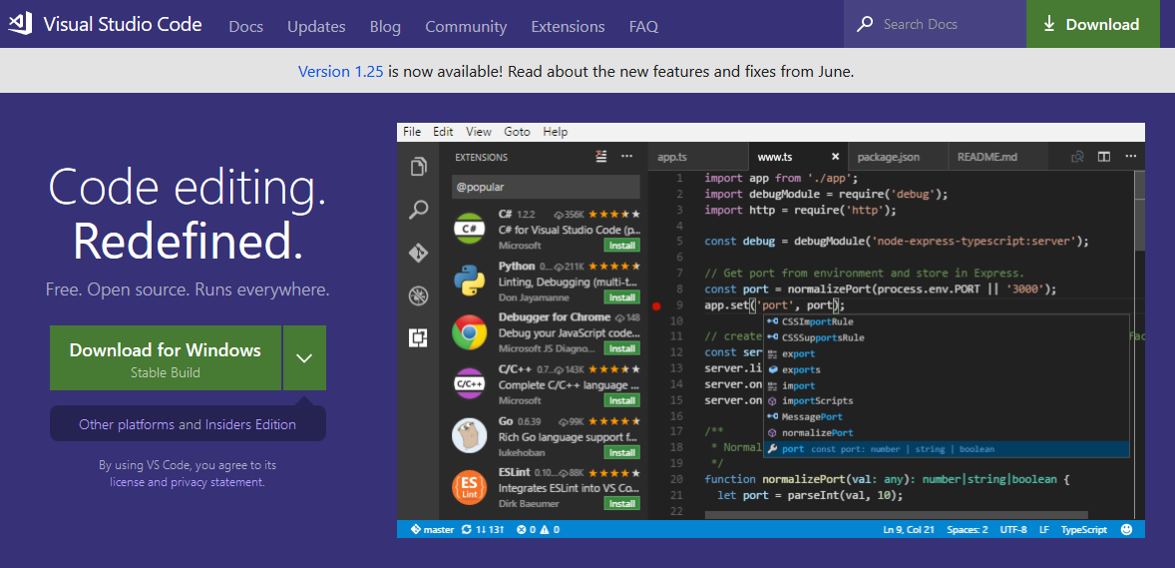
Visual Studio Code

Slide 11
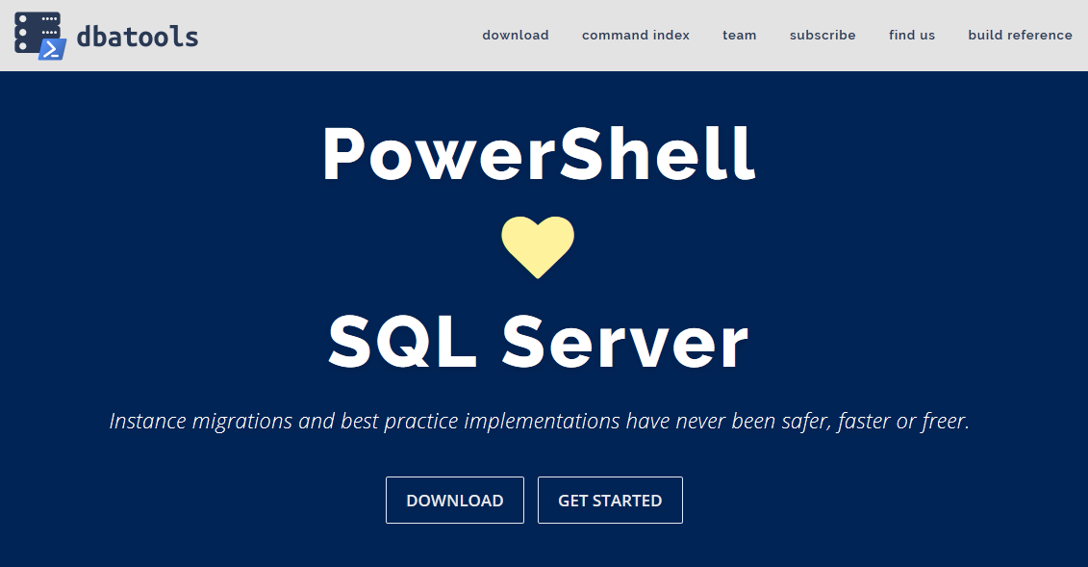
dbatools

Slide 12
Demos

Slide 13
Case Study

Slide 14
Problem
QA/Dev departments repeatedly creating new VMs
All VMs require a local instance of SQL Server
SQL installed from chocolately
30+ databases then restored from baselines via PoSH scripts
SQL install taking ~40 minutes from start to finish

Slide 15
Solution
Containers!
Implement containers running SQL Server for new VMs
SQL containers built from custom image
No longer need to install SQL
No longer need to restore databases
Resources freed up on VMs

Slide 16
WinDocks
www.windocks.com
A port of the open source project from Docker Inc.
Software supports the creation of containers running earlier versions of SQL Server (2008+) on Windows Server 2012
Free Community Edition available
www.windocks.com/leads/add?src=downloadcommunity

Slide 17
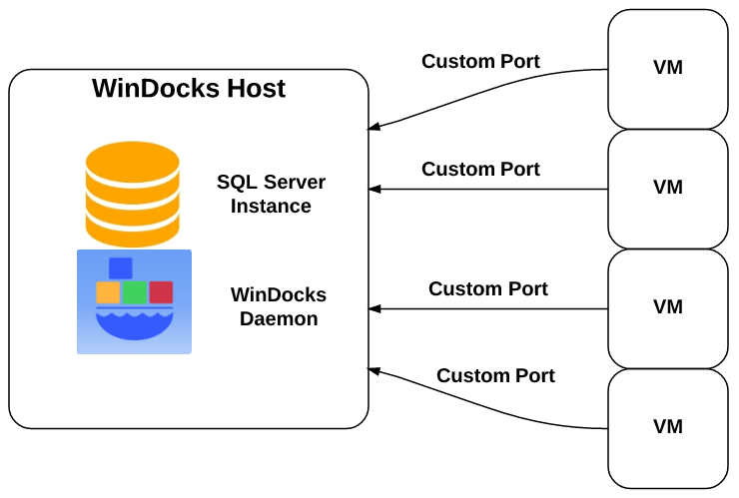
Architecture

Slide 18
Benefits
New VMs deployed in a fraction of the previous time
No longer need to run PoSH scripts to restore databases
Base image can be used to keep containers at production SQL instance’s patch level
More VMs can be provisioned on host due to each VM requiring less resources

Slide 19
Issues
Apps using DNS entries to reference local SQL instance
Update to existing test applications
Trial and error to integrate with Octopus deploy
New ways of thinking

Slide 20
Resources

Slide 21
Other SQL Images
On the Docker Hub
docker pull dbafromthecold/sqlserver2012dev:sp4
docker pull dbafromthecold/sqlserver2014dev:sp2
docker pull dbafromthecold/sqlserverlinuxagent:2017-GA
Code on GitHub
https://github.com/dbafromthecold/SQLServerAndContainersDemo

Slide 22
Further Information
Summary of Container Series
https://dbafromthecold.com/2017/03/15/summary-of-my-container-series/
Case Study on SQLServerCentral.com
http://www.sqlservercentral.com/articles/containers/154337/
Docker on Windows Server Core
https://www.sqlshack.com/running-sql-server-containers-windows-server-2016-core/

